Slide 1
Competitive Programming Input and Output
Dr. Naveen Kumar
Associate Professor
Amity Institute of Information Technology
Amity University Patna

Slide 2
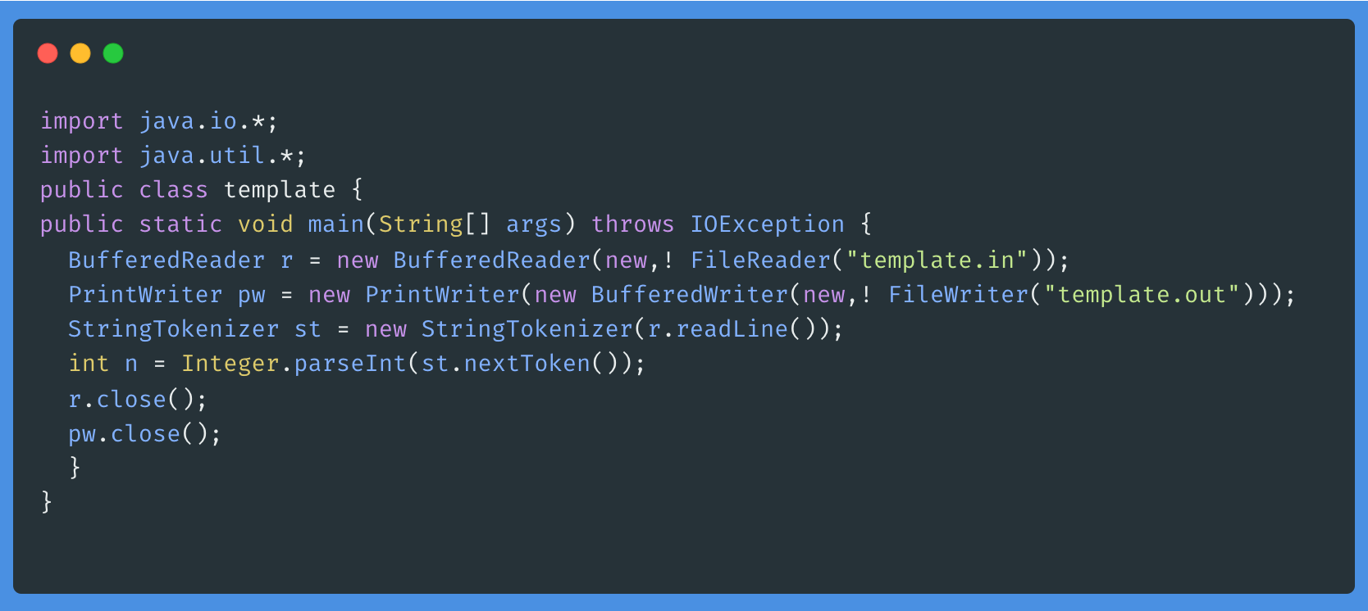
Input and Output

Slide 3
Important functions that are used in reading input and printing output
Method | Description
r.readLine() | Reads the next line of the input
st.nextToken() | Reads the next token (up to a whitespace) and returns as a ‘String‘.
Integer.parseInt | Converts the ‘String‘ returned by the ‘StringTokenizer‘ to an ‘int‘.
Double.parseDouble | Converts the ‘String‘ returned by the ‘StringTokenizer‘ to a ‘double‘.
Long.parseLong | Converts the ‘String‘ returned by the ‘StringTokenizer‘ to a ‘long‘
pw.println() | Prints the argument to designated output stream and adds newline
pw.print() | Prints the argument to designated output stream

Slide 4
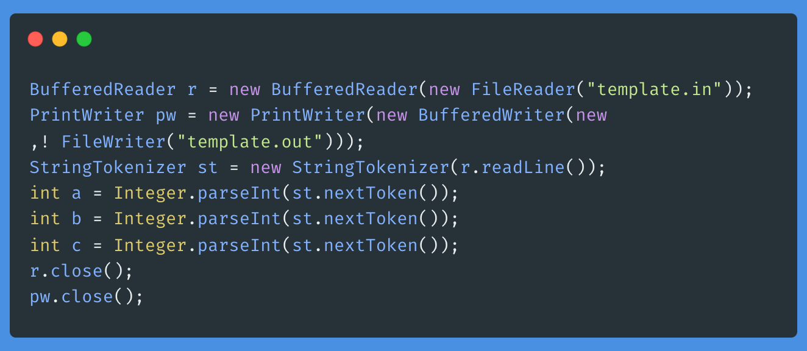

Slide 5
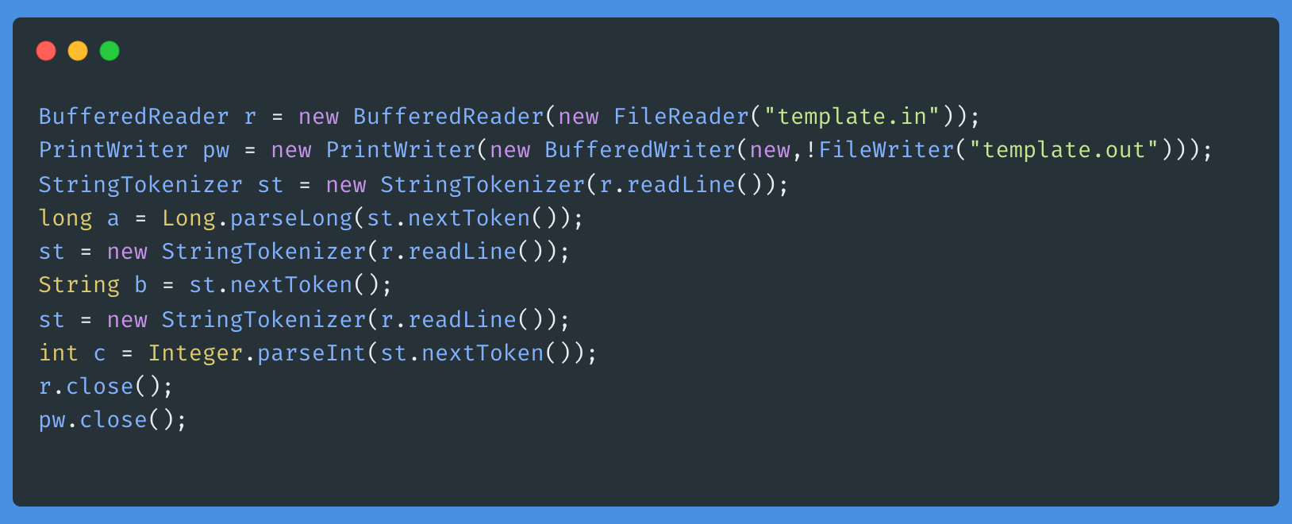

Slide 6
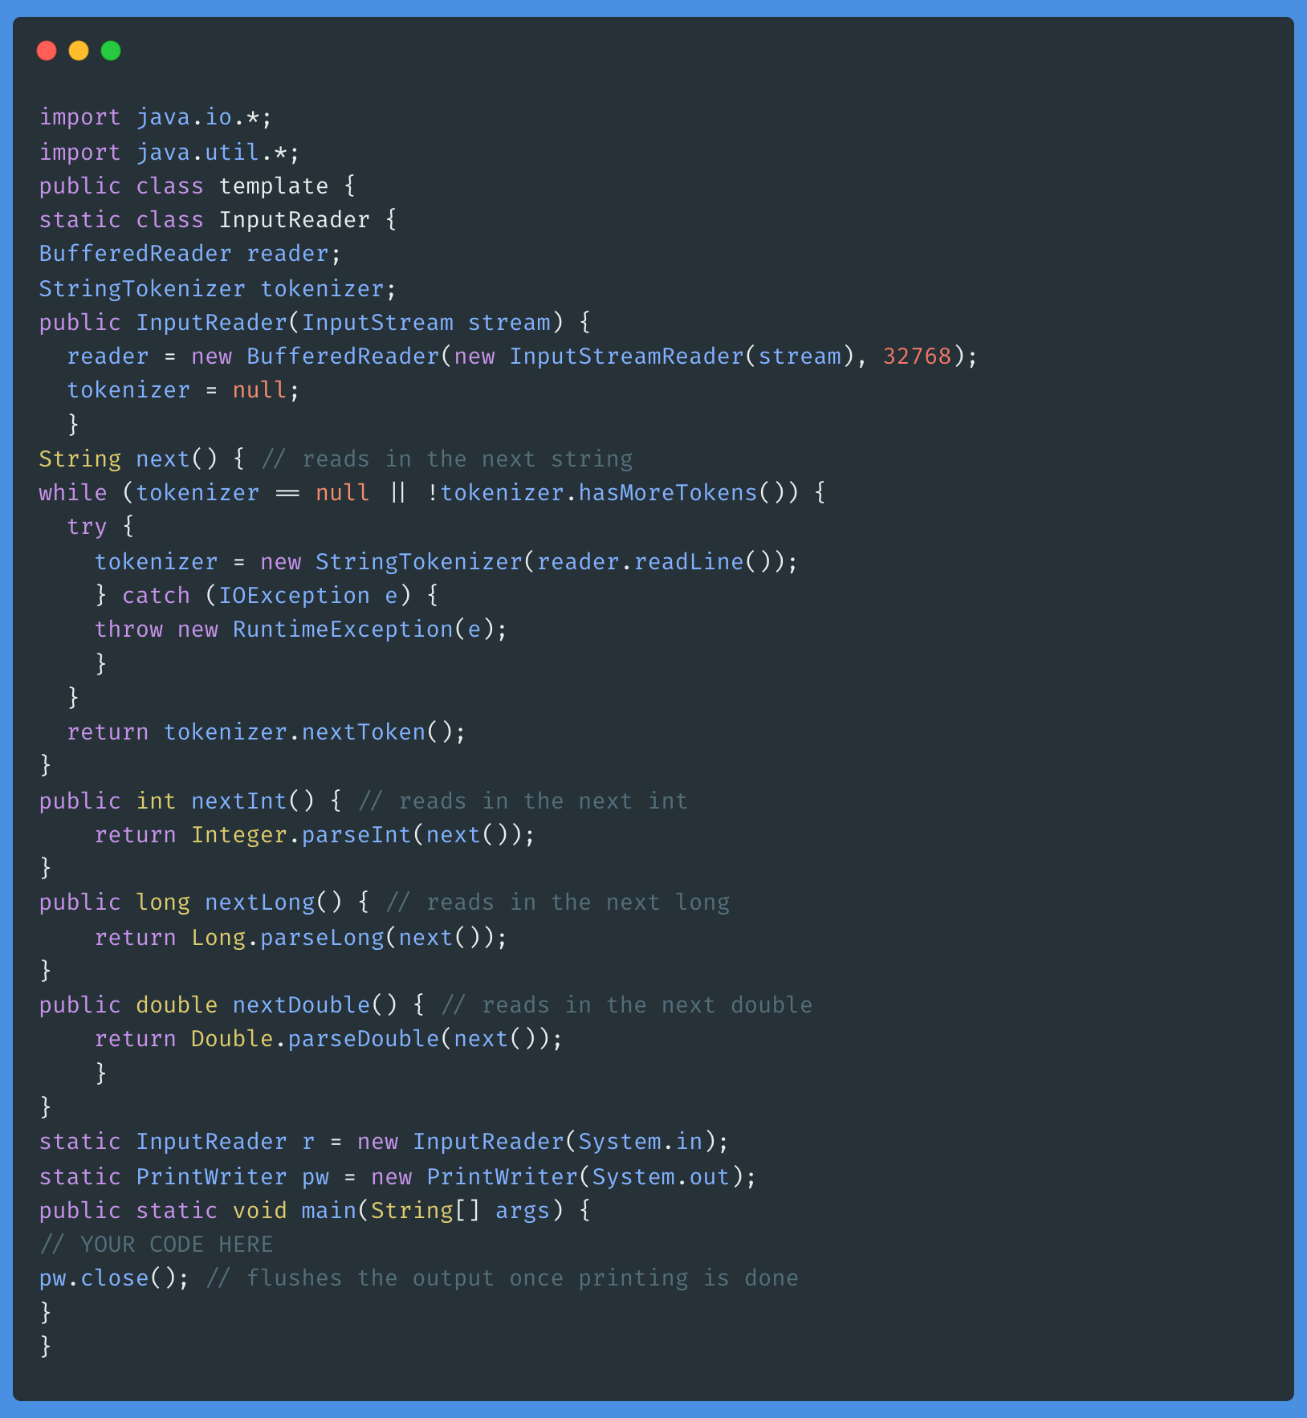

Slide 7
Bit Manipulation

Slide 8
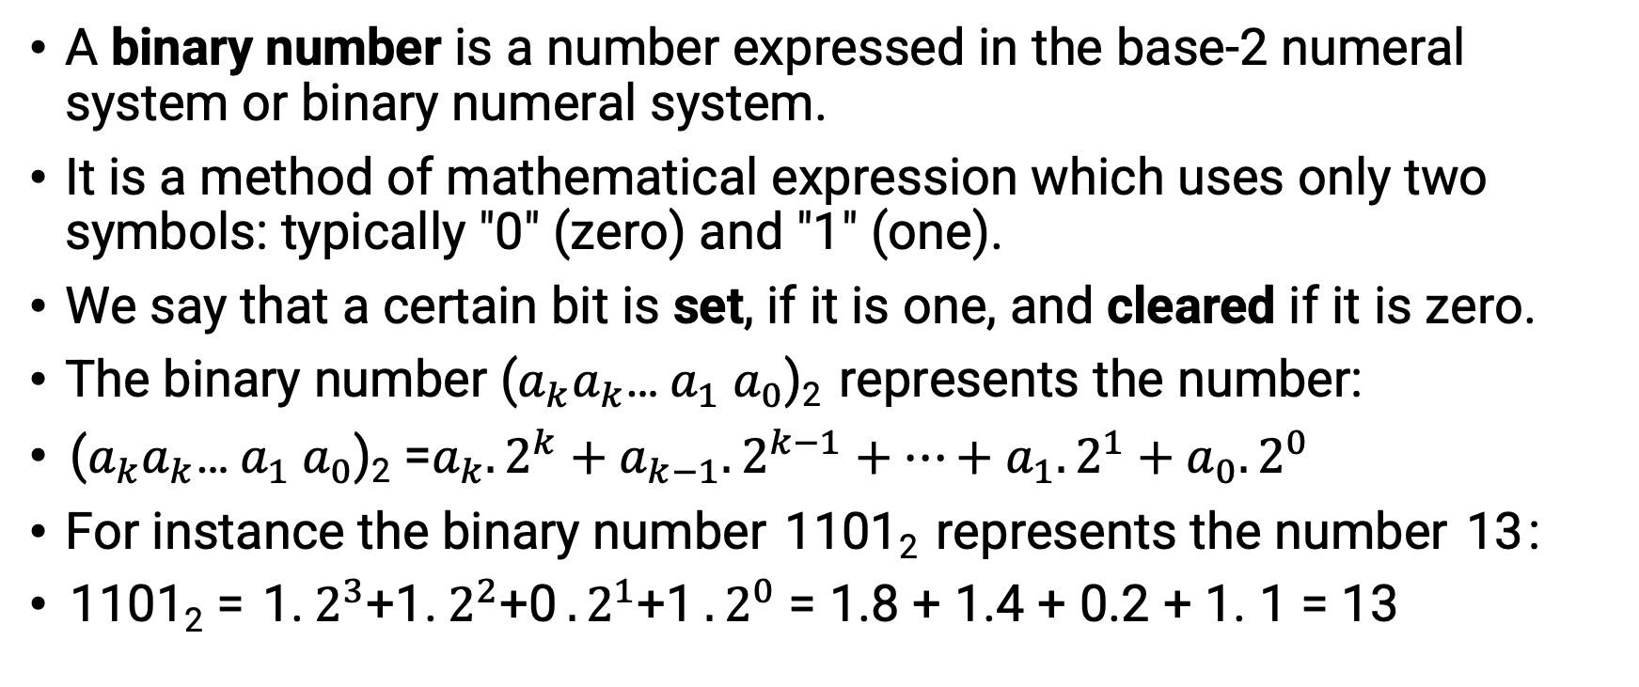
Binary number
A binary number is a number expressed in the base-2 numeral system or binary numeral system.
It is a method of mathematical expression which uses only two symbols: typically "0" (zero) and "1" (one).
We say that a certain bit is set, if it is one, and cleared if it is zero.
The binary number ($a_{k}a_{k}$… $a_{1} a_{0}$)₂ represents the number:
($a_{k}a_{k}$… $a_{1} a_{0}$)₂ =$a_{k}.2^{k}+a_{k−1}.2^{k−1}+…+a_{1}.2^{1}+a_{0}.2^{0}$
For instance the binary number 1101₂ represents the number 13 :
1101₂ = 1. $2^{3}$+1. $2^{2}$+0 $.2^{1}$+1 $.2^{0}$ = 1.8 + 1.4 + 0.2 + 1. 1 = 13

Slide 9
Binary number
Computers represent integers as binary numbers.
Positive integers (both signed and unsigned) are just represented with their binary digits, and
Negative signed numbers (which can be positive and negative) are usually represented with the Two's complement.
CPUs are very fast at manipulating those bits with specific operations.
So, for some problems, we can leverage these binary number representations to speed up execution.
And for some problems (typically in combinatorics or dynamic programming) where we want to track which objects we already picked from a given set of objects, we can just use a large enough integer where each digit represents an object and depending on it, we pick or drop the object we set or clear the digit.

Slide 10
Binary number
unsigned int unsigned_number = 13;
assert(unsigned_number == 0b1101);
int positive_signed_number = 13;
assert(positive_signed_number == 0b1101);
int negative_signed_number = -13;
assert(negative_signed_number == 0b1111'1111'1111'1111'1111'1111'1111'0011);

Slide 11
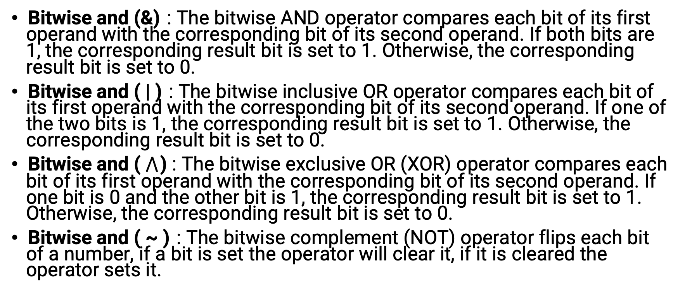
Bit operators
Bitwise and (&) : The bitwise AND operator compares each bit of its first operand with the corresponding bit of its second operand. If both bits are 1, the corresponding result bit is set to 1. Otherwise, the corresponding result bit is set to 0.
Bitwise and ( | ) : The bitwise inclusive OR operator compares each bit of its first operand with the corresponding bit of its second operand. If one of the two bits is 1, the corresponding result bit is set to 1. Otherwise, the corresponding result bit is set to 0.
Bitwise and ( $⋀$ ) : The bitwise exclusive OR (XOR) operator compares each bit of its first operand with the corresponding bit of its second operand. If one bit is 0 and the other bit is 1, the corresponding result bit is set to 1. Otherwise, the corresponding result bit is set to 0.
Bitwise and ( ~ ) : The bitwise complement (NOT) operator flips each bit of a number, if a bit is set the operator will clear it, if it is cleared the operator sets it.

Slide 12



Slide 13



Slide 14
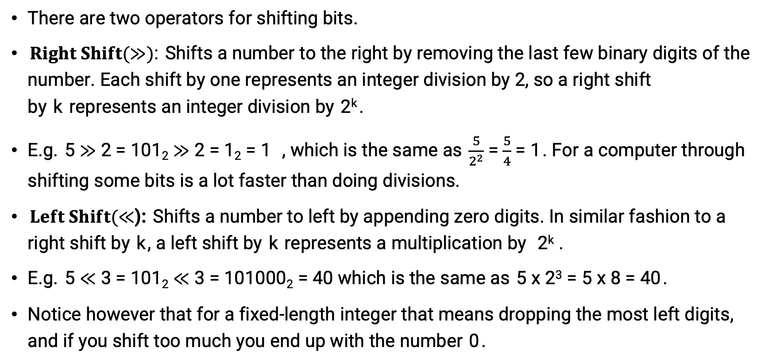
Shift operators
There are two operators for shifting bits.
$Right Shift(≫)$: Shifts a number to the right by removing the last few binary digits of the number. Each shift by one represents an integer division by 2, so a right shift by k represents an integer division by 2^{k} .
E.g. 5 $≫$ 2 = 101₂ $≫$ 2 = 1₂ = 1 , which is the same as $\frac{5}{2^{2}}$ = $\frac{5}{4}$ = 1 . For a computer through shifting some bits is a lot faster than doing divisions.
$Left Shift(≪$): Shifts a number to left by appending zero digits. In similar fashion to a right shift by k , a left shift by k represents a multiplication by 2^{k} .
E.g. 5 $≪$ 3 = 101₂ $≪$ 3 = 101000₂ = 40 which is the same as 5 x 2³ = 5 x 8 = 40 .
Notice however that for a fixed-length integer that means dropping the most left digits, and if you shift too much you end up with the number 0 .

Slide 15
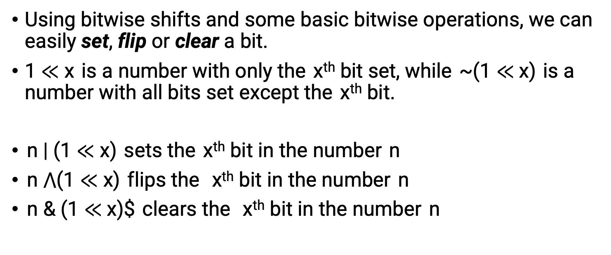
Useful tricks (Set/flip/clear a bit)
Using bitwise shifts and some basic bitwise operations, we can easily set, flip or clear a bit.
1 $≪$ x is a number with only the x^{th} bit set, while ~(1 $≪$x) is a number with all bits set except the x^{th} bit.
n | (1 $≪$ x) sets the x^{th} bit in the number n
n $⋀$(1 $≪$ x) flips the x^{th} bit in the number n
n & (1 $≪$x)$ clears the x^{th} bit in the number n

Slide 16
Useful tricks (Check if a bit is set)
The value of the x^{th} bit can be checked by shifting the number x positions to the right, so that the x^{th} bit is at the unit place, after which we can extract it by performing a bitwise & with 1.
bool is_set(unsigned int number, int x) {
return (number >> x) & 1;
}

Slide 17
Check if the number is divisible by a power of 2
Using the and operation, we can check if a number n is even because n & 1 = 0 if n is even, and n & 1 = 1 if n is odd.
More generally, n is divisible by 2^{k} exactly when n & (2^{k}−1) = 0 .
bool isDivisibleByPowerOf2(int n, int k) {
int powerOf2 = 1 << k; return (n & (powerOf2 - 1)) == 0;
}
We can calculate 2^{k} by left shifting 1 by k positions. The trick works, because 2^{k} -1$ is a number that consists of exactly k ones. And a number that is divisible by 2^{k} must have zero digits in those places.

Slide 18
Check if an integer is a power of 2
A power of two is a number that has only a single bit in it (e.g. 32 = 0010 0000₂ ), while the predecessor of that number has that digit not set and all the digits after it set ( 31 = 0001 1111₂ ). So the bitwise AND of a number with it's predecessor will always be 0, as they don't have any common digits set. You can easily check that this only happens for the the power of twos and for the number 0 , which already has no digit set.
bool isPowerOfTwo(unsigned int n) {
return n && !(n & (n - 1));
}

Slide 19

Clear the right-most set bit
The expression n & (n-1) can be used to turn off the rightmost set bit of a number n .
This works because the expression n-1 flips all bits after the rightmost set bit of n , including the rightmost set bit.
So all those digits are different from the original number, and by doing a bitwise AND they are all set to 0, giving you the original number n with the rightmost set bit flipped.
For example, consider the number 52 = 0011 0100₂ :

Slide 20
Brian Kernighan's algorithm
We can count the number of bits set.
The idea is to consider only the set bits of an integer by turning off its rightmost set bit (after counting it), so the next iteration of the loop considers the Next Rightmost bit.
int countSetBits(int n) {
int count = 0; while (n) {
n = n & (n - 1);
count++;
}
return count;
}

Slide 21
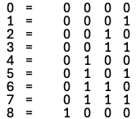
Count set bits upto n
To count the number of set bits of all numbers upto the number n (inclusive), we can run Brian Kernighan's algorithm on all numbers upto n . But this will result in a "Time Limit Exceeded" in contest submissions.
We can use the fact that for numbers upto
2^{x} (i.e. from 1 to 2^{x} - 1 ) there are x . 2^{x-1} set bits.
This can be visualised as follows.
We can see that all the columns except the
leftmost have 4 (i.e. 2² ) set bits each, i.e. upto
the number 2³ - 1 , the number of set bits is 3 . 2³⁻¹ .

Slide 22
Count set bits upto n
With the new knowledge in hand we can come up with the following algorithm:
Find the highest power of 2 that is less than or equal to the given number. Let this number be x .
Calculate the number of set bits from 1 to 2^{x - 1} by using the formula x . 2^{x-1} .
Count the number of set bits in the most significant bit from 2^{x} to n and add it.
Subtract 2^{x} from n and repeat the above steps using the new n .

Slide 23
Count set bits upto n
int countSetBits(int n) {
int count = 0;
while (n > 0) {
int x = std::bit_width(n) - 1;
count += x << (x - 1);
n -= 1 << x;
count += n + 1;
}
return count;
}

Slide 24

Additional tricks
n & (n + 1) clears all trailing ones: 0011 0111₂ $→$0011 0000₂ .
n | (n + 1) sets the last cleared bit: 0011 0101₂ $→$ 0011 0111₂ .
n & -n extracts the last set bit: 0011 0100₂ $→$ 0000 0100₂ .

